Slide 1


PROJECT WORK
Face Recognition based Facial
Expression Analysis
M.PRIYADHARSHINI (412620243018)
H.DEEPA (412620243005)
S.SYED JASIM (412620243027)
Supervisor
Mr. Alphin Ezhil Manuel
Professor
Department of Artificial Intelligence and Data Science.

Slide 2
ABSTRACT OF THE PROJECT
Nowadays, deep learning techniques are a big success in various fields including computer vision. Indeed, a convolutional neural networks (CNN) model can be trained to analyze images and identify face emotion. In this project, we create a system that recognizes students’ emotions from their faces. Our system consists of three phases: face detection using Haar Cascades, normalization and emotion recognition using CNN on a Face Emotion Recognition database with seven types of expressions. Obtained results show that face emotion recognition is feasible in education, consequently, it can help teachers to modify their presentation according to the students’ emotions.

Slide 3
LITERATURE REVIEW
1. Advancements in Deep Face Recognition:
Taigman et al. (2020) present state-of-the-art research on deep face recognition, showcasing its remarkable performance in handling challenging conditions such as variations in lighting, pose, and expression. This advancement in facial recognition technology holds significant implications for education, enabling more accurate identification of students.
2. Role of Convolutional Neural Networks (CNNs) in Facial Recognition:
Schroff et al. (2021) discuss the pivotal role of (CNNs) in advancing facial recognition algorithms. CNNs excel in extracting meaningful features from visual data, making them indispensable for tasks such as face detection, landmark localization, and emotion recognition.

Slide 4
In educational contexts, CNN-based facial recognition systems empower educators with valuable insights into students' emotional responses and learning progress.
3. Behavior Analysis Using Computer Vision Techniques:
Salah et al. (2022) explore the application of computer vision techniques in behavior analysis, By leveraging advanced algorithms for motion tracking, gesture recognition, and facial expression analysis, researchers can gain deeper insights into students' behaviors during learning activities, enabling more effective pedagogical interventions.
4. Behavioral Analytics for Student Engagement:
D'Mello et al. (2019) delve into the realm of behavioral analytics in education, through the analysis of facial expressions, body language, and interaction patterns, educators can gain valuable insights into students' cognitive and emotional states, enabling timely interventions to support learning.

Slide 5
OBJECTIVES
Facial expression analysis in education promises to revolutionize teaching by providing real-time feedback on students' emotions.
This technology enables educators to adapt their teaching methods based on students' emotional states, fostering a more engaging and inclusive learning environment.
By recognizing signs of confusion, frustration, or disinterest, teachers can adjust their approach to better support student comprehension and engagement.

Slide 6
Moreover, facial analysis can personalize learning experiences by catering to individual emotional responses, promoting deeper understanding and retention of material.
While the implementation of this technology requires careful consideration of ethical and privacy concerns, its potential to enhance teaching effectiveness and student outcomes is significant.

Slide 7
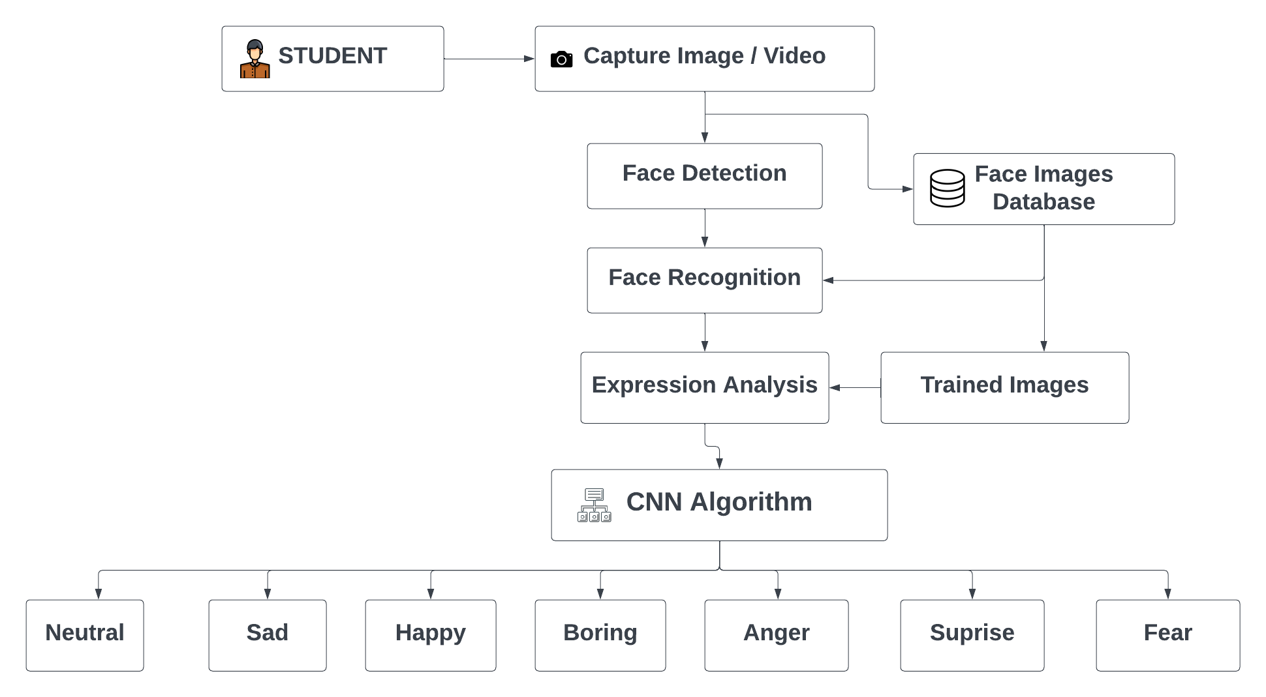
FLOW CHART

Slide 8
ALGORITHM:
Haar cascade Algorithm :
It is a machine learning based approach where a cascade function is trained from a lot of positive and negative images (where positive images are those where the object to be detected is present, negative are those where it is not). It is then used to detect objects in other images. Luckily, OpenCV offers pre-trained Haar cascade algorithms, organized into categories (faces, eyes and so forth), depending on the images they have been trained on.

Slide 9
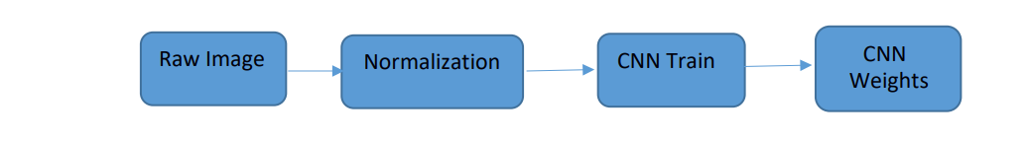
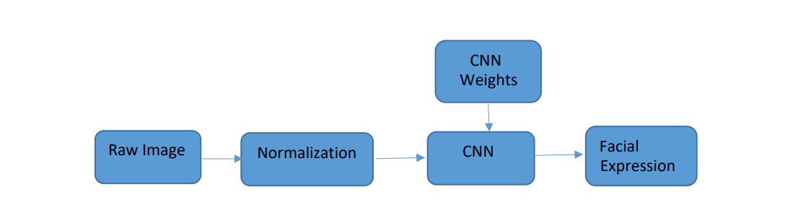
METHODOLOGY :
The facial expression recognition system is implemented using convolutional neural networks. The block diagram of the system is shown in following figures:
Training Phase:
2. Testing Phase:

Slide 10
PROPOSED SYSTEM
we describe our proposed system to analyze students’ facial expressions using a Convolutional Neural Network (CNN) architecture. First, the system detects the face from the input image and these detected faces are cropped and normalized to a size of 48×48. Then, these face images are used as input to CNN. Finally, the output is the facial expression recognition results (anger, happiness, sadness, disgust, surprise or neutral).

Slide 11
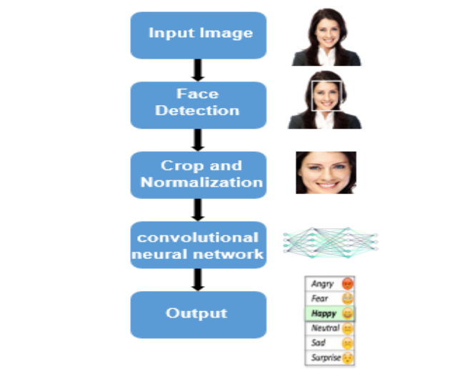

Slide 12

CNN (Convolutional Neural Network)
The important unit inside CNN layers is a neuron. They are connected together, in order that the output of neurons at a layer becomes the input of neurons at the next layer. In order to compute the partial derivatives of the cost function the backpropagation algorithm is used. The term convolution refers to the use of a filter or kernel on the input image to produce a feature map. In fact, CNN model contains 3 types of layers

Slide 13
Convolution operation:
Convolution layer is the first layer to extract features from an input image.Convolution preserves the spatial relationship between pixels by learning image features using small squares of input data . It performs a dot product between two matrices, where one is the image and the other is a kernel.
The convolution formula is represented in Equation :
net(t, f) (x * w)[t, f] ∑m ∑n x[m, n]w[t m, f n]
Where net(t, f) is the output in the next layer, x is the input image, w is the filter matrix and * is the convolution operation.

Slide 14
Pooling
It reduces the dimensionality of each feature map but retains the most important information . Pooling can be of different types : Max Pooling, Average Pooling and Sum Pooling. The function of Pooling is to progressively reduce the spatial size of the input representation and to make the network invariant to small transformations, distortions and translations in the input image.
Fully Connected Layer:
Fully connected layer is a traditional Multi Layer Perceptron that uses an activation function in the output layer. The term “Fully Connected” implies that every neuron in the previous layer is connected to every neuron on the next layer.

Slide 15
The purpose of the Fully Connected layer is to use the output of the convolutional and pooling layers for classifying the input image into various classes based on the training dataset. So the Convolution and Pooling layers act as Feature Extractors from the input image while the Fully Connected layer acts as a classifier.
4 convolutional layers with 4 pooling layers to extract features, and 2 fully connected layers then the softmax layer with 7 emotion classes. Input image is grayscale face image with a size of 48×48. For each convolutional layer we used 3×3 filters with stride 2. For the pooling layers, we used max pooling layer and 2×2 kernels with stride 2.

Slide 16
Data Augmentation:
we defined our CNN model with 4 convolutional layers, 4 pooling layers and 2 fully connected layers. After that, to provide non linearity in our CNN model we applied the ReLU function and we used batch normalization to normalize the activation of the precedent layer at each batch and L2 regularization to apply penalties on the different parameters of the model. Thus, we chose softmax as our last activation function, it takes as input a vector z of k numbers and normalizes it into a probability distribution.

Slide 17
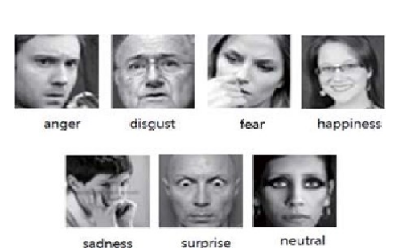
SAMPLE DATA SET

Slide 18

OUTPUT:

Slide 19
CONCLUSION
We presented a Convolutional Neural Network model for students’ facial expression recognition. The proposed model includes 4 convolutional layers, 4 max pooling and 2 fully connected layers. The system recognizes faces from students’ input images using Haar-like detector and classifies them into seven facial expressions: surprise, fear, disgust, sad, happy, angry and neutral. The proposed model achieved an accuracy rate of 70% on FER 2013 database. Our facial expression recognition system can help the teacher to recognize students’ comprehension towards his presentation. Thus, in our future work we will focus on applying Convolutional Neural Network model on 3D students’ face image in order to extract their emotions.

